Slide 1
pollution
Submitted by gayatri

Slide 2
overview
Definition of pollution
Types of pollution
Air pollution
a. introduction b. Effects
c. causes d. prevention
Water pollution
a. introduction b. Effects
c. causes d. prevention

Slide 3
1. Renewable fuel and clean energy production
The most basic solution for air pollution is to move away from fossil fuels, replacing them with alternative energies like solar, wind and geothermal.
2. Energy conservation and efficiency
Producing clean energy is crucial. But equally important is to reduce our consumption of energy by adopting responsible habits and using more efficient devices.
3. Eco-friendly transportation
Shifting to electric vehicles and hydrogen vehicles, and promoting shared mobility (i.e carpooling, and public transports) could reduce air pollution.
4. Green building
From planning to demolition, green building aims to create environmentally responsible and resource-efficient structures to reduce their carbon footprint.

Slide 4
overview
Noise pollution
a. introduction b. Effects

Slide 5
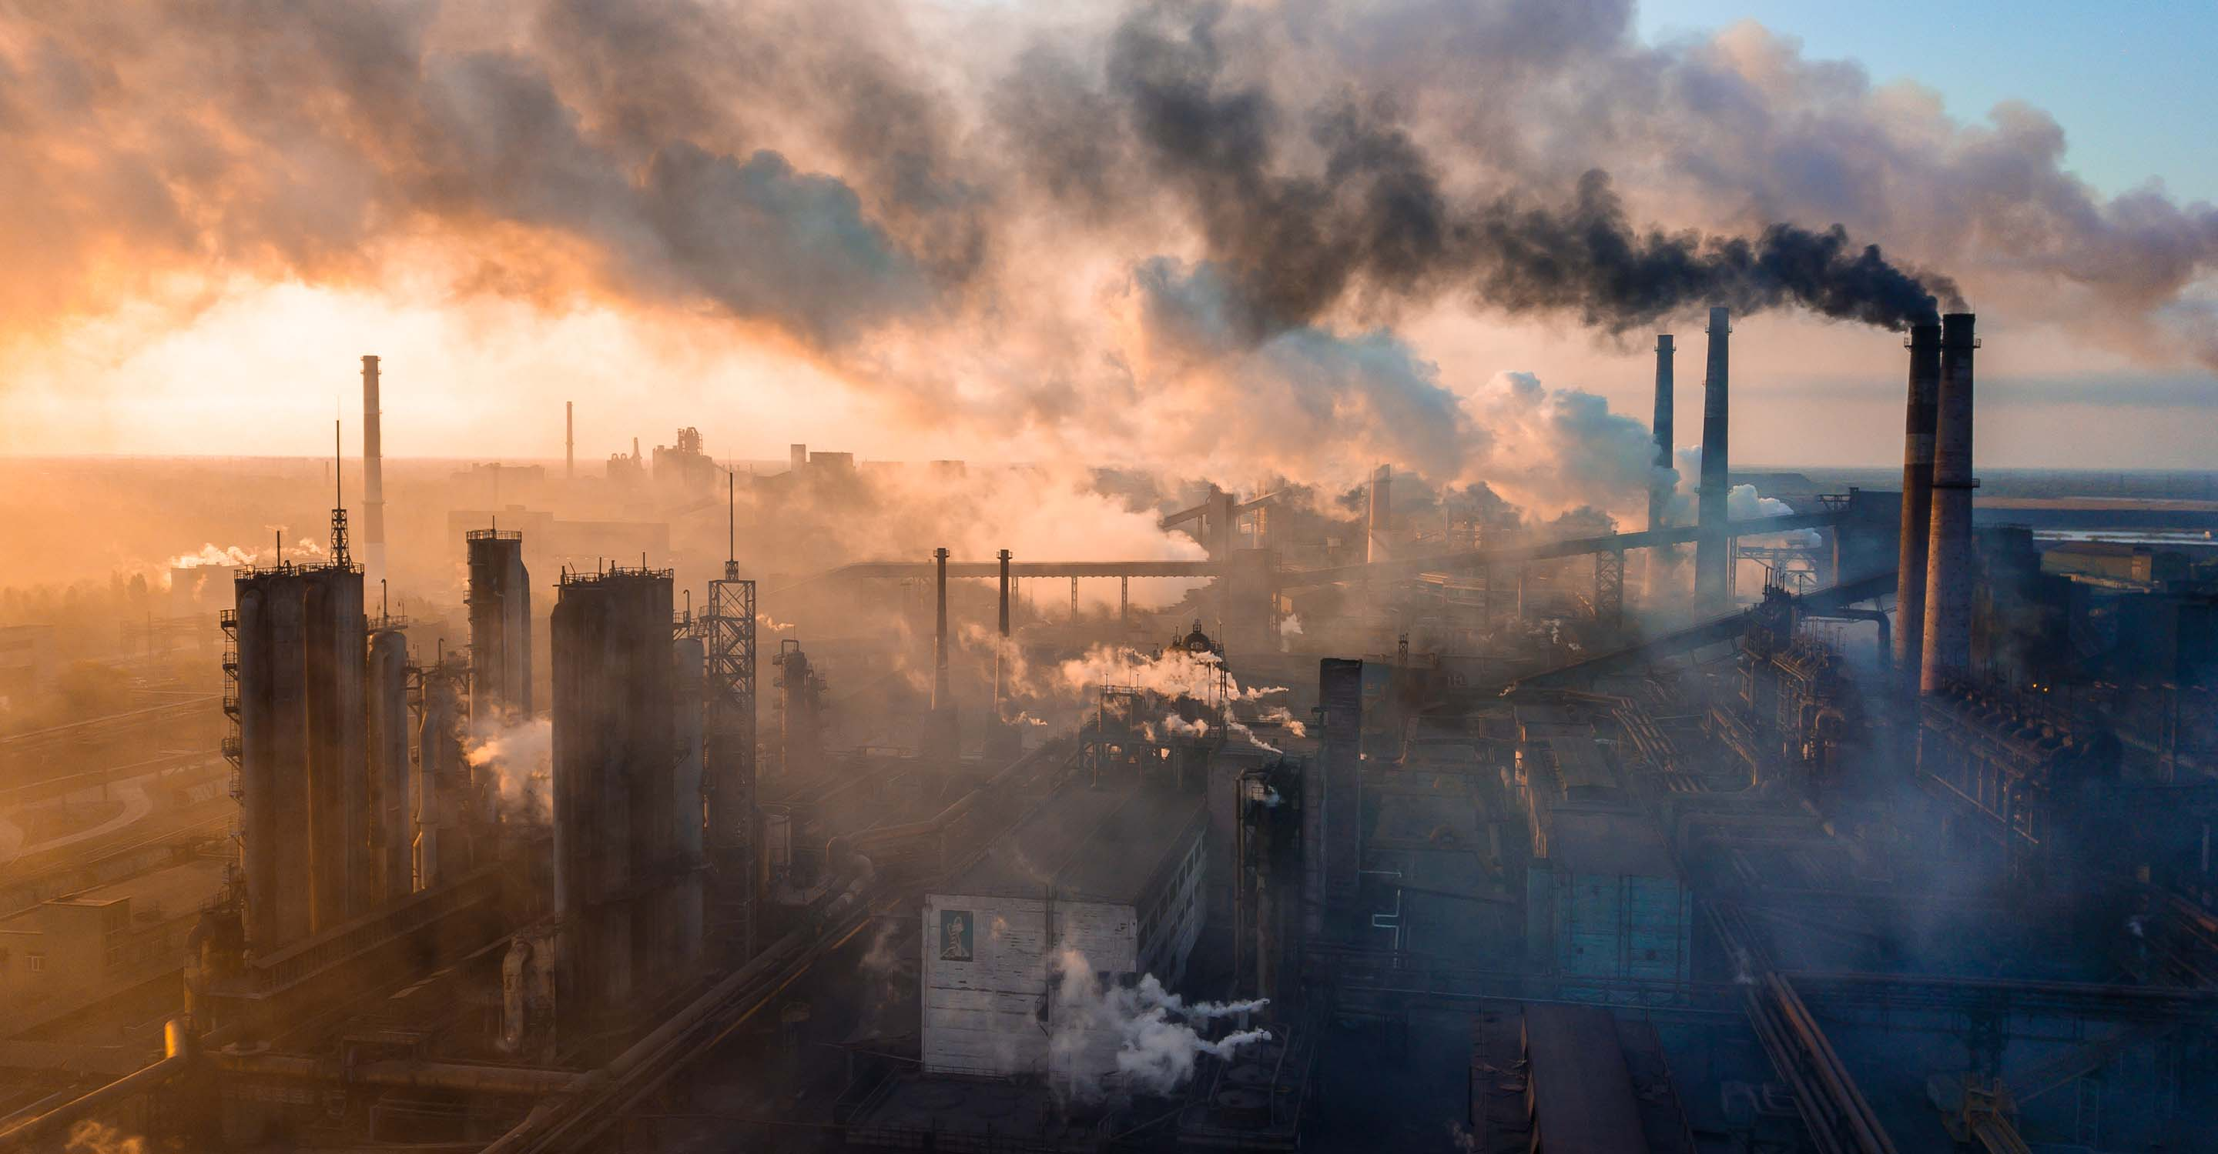
air pollution
Air pollution can be defined as an alteration of air quality that can be characterized by measurements of chemical, biological or physical pollutants in the air. Therefore, air pollution means the undesirable presence of impurities or the abnormal rise in the proportion of some constituents of the atmosphere. It can be classified in 2 sections: visible and invisible air pollution.
Local
this concerns the quality of ambient air within a radius of a few kilometers
Regional
pollution like acid rain, photochemical reactions and degradation of water quality at distances of a few kilometers to a thousand kilometers
Global
depletion of the ozone layer and global warming caused by the emission of greenhouse gases, mainly carbon dioxide (CO2)

Slide 6
Effects of air pollution
With every breath we take, we suck in tiny particles that can damage our lungs, hearts, and brains and cause a host of other health problems. The most dangerous of these particles, which can include anything from soot, soil dust, to sulfates, are fine particles 2.5 microns or less in diameter —shortened as PM2.5.
In 2021, in response to increases in quality and quantity of evidence of air pollution impacts, the WHO updated the PM2.5 annual mean air quality guideline to 5µg/m3, which represents clean air as few impacts have been observed below these levels. The update halves the previous 2005 guideline level of 10µg/m3. On the way to that level, the agency also sets a series of interim targets, air pollutant concentrations that serve as steppingstones. They are meant for areas where air pollution is high, so governments in those areas can develop policies to reduce air pollution that are achievable within realistic time frames.
Even though air pollution is a global problem, it disproportionately affects those living in developing nations and particularly the most vulnerable, such as women, children and the elderly.

Slide 7
Air pollution causes
Air pollution is caused by the presence in the atmosphere of toxic substances, mainly produced by human activities, even though sometimes it can result from natural phenomena such as volcanic eruptions, dust storms and wildfires, also depleting the air quality.
Anthropogenic air pollution sources are:
1.
Combustion of fossil fuels, like coal and oil for electricity and road transport, producing air pollutants like nitrogen and sulfur dioxide
2.
Emissions from industries and factories, releasing large amount of carbon monoxide, hydrocarbon, chemicals and organic compounds into the air
3.
Agricultural activities, due to the use of pesticides, insecticides, and fertilizers that emit harmful chemicals
4.
Waste production, mostly because of methane generation in landfills

